Slide 1
Isotropic Surface Remeshing
Matteo Caroli

Slide 2
A remeshing work in 8 steps
Cutting
Conformal parameterization
Spanning tree over adjacent triangle graph and feature edges
Error propagation
Place new vertices and compute the Delaunay triangulation
Voronoi tessellation
Lloyd relaxation
Pull back up the parameterized new mesh.

Slide 3
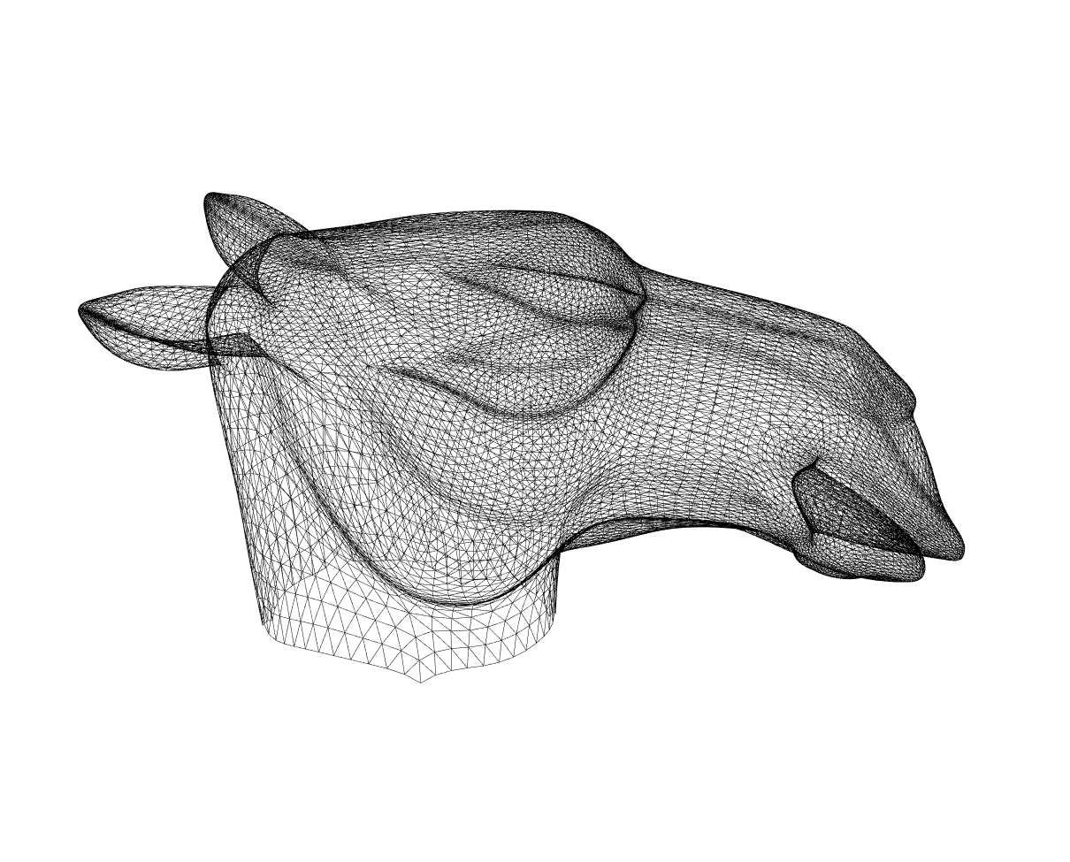
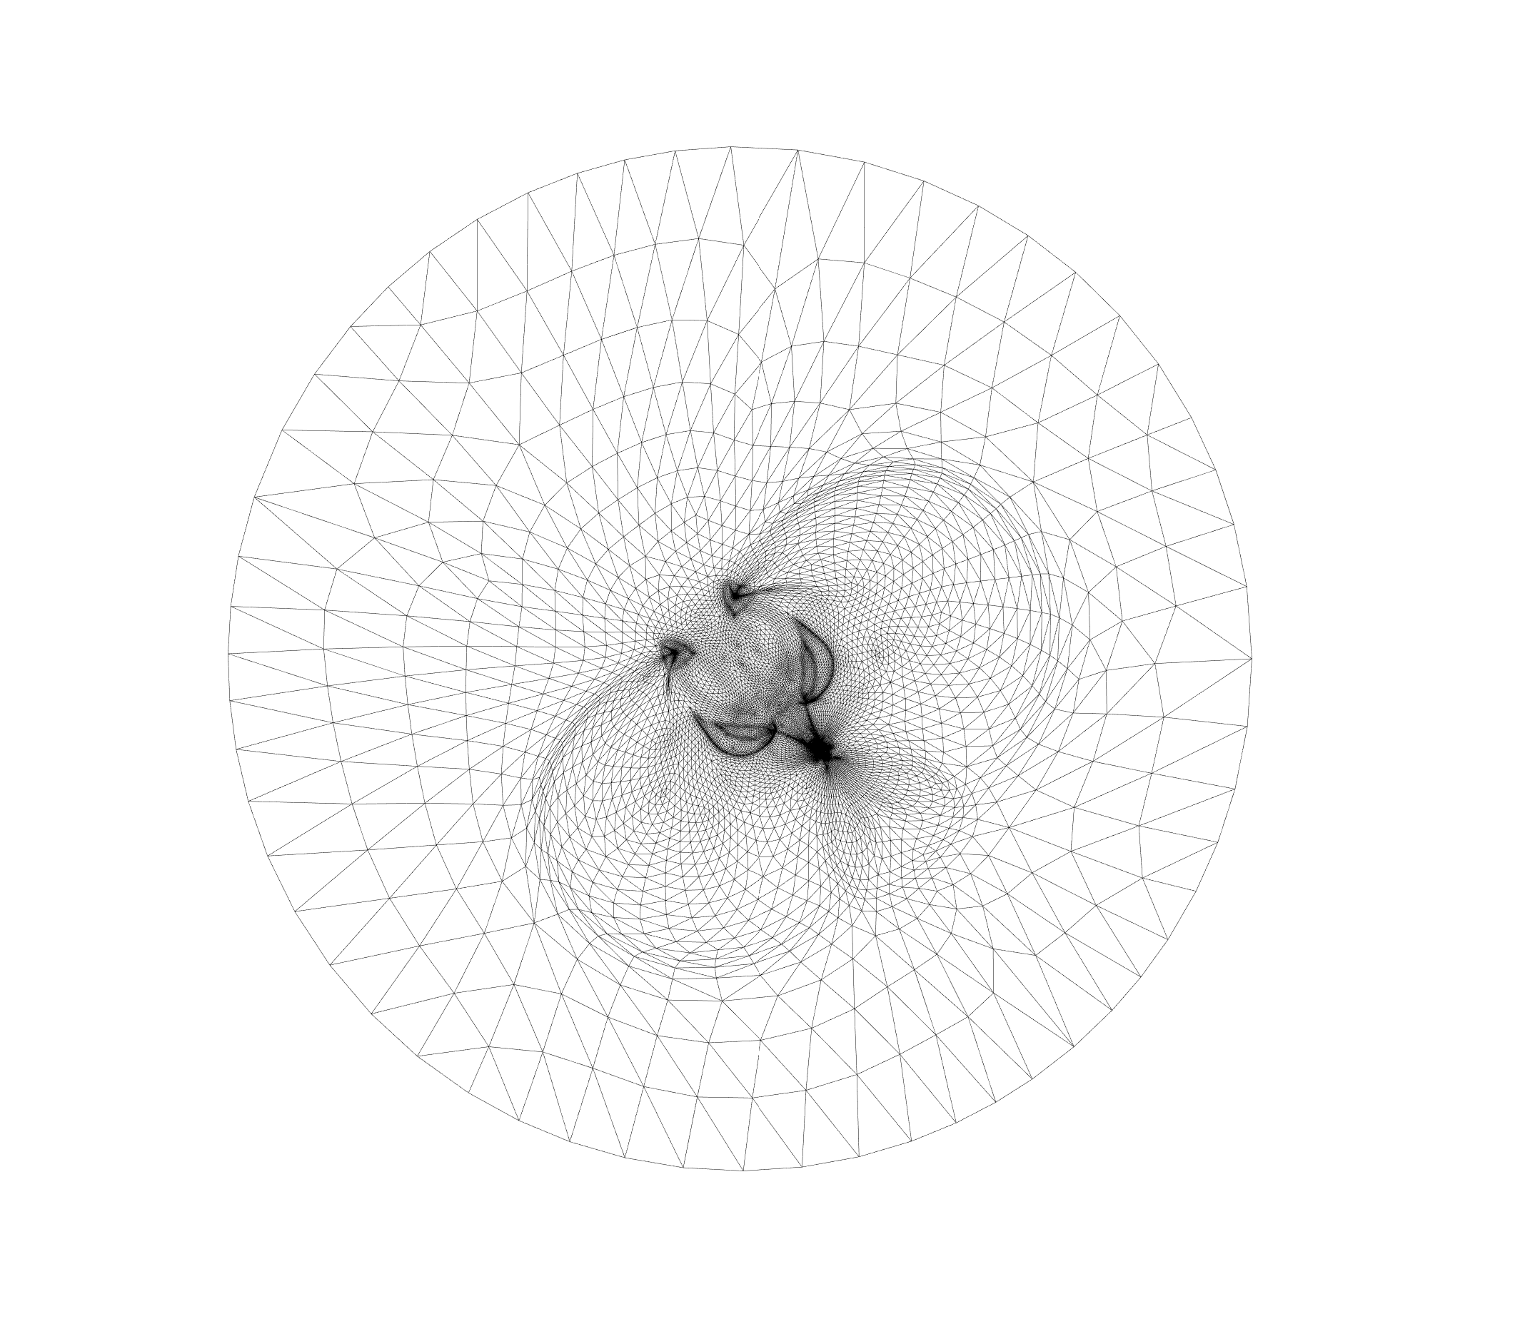
Conformal parameterization
Original Mesh
parameterized Mesh

Slide 4
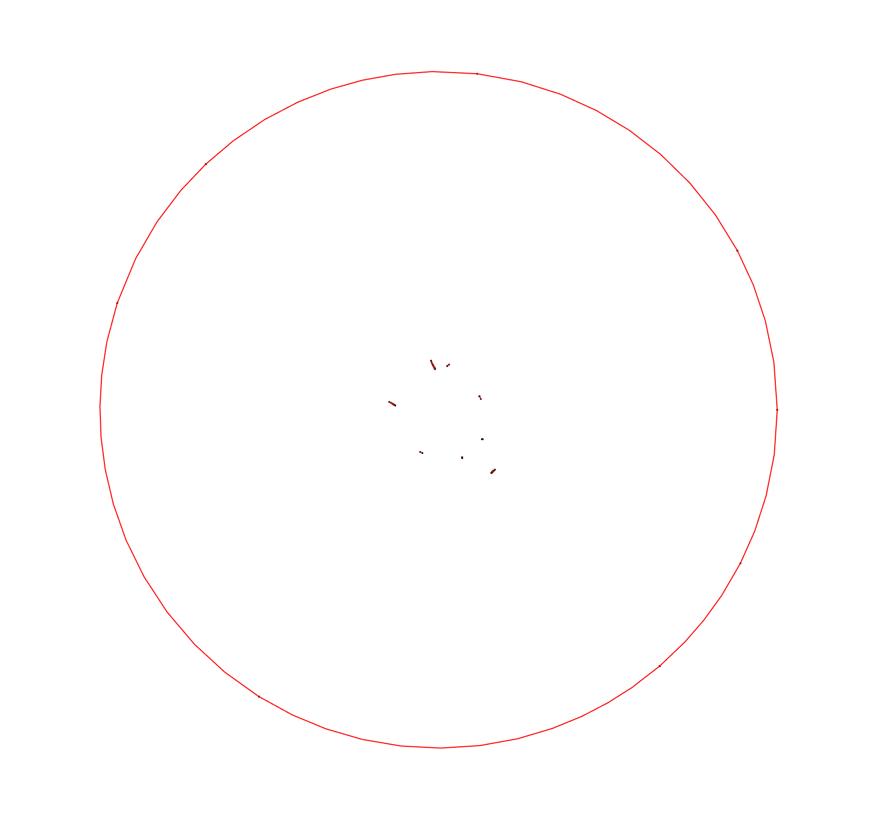
Extract Feature Edges and Corners

Slide 5
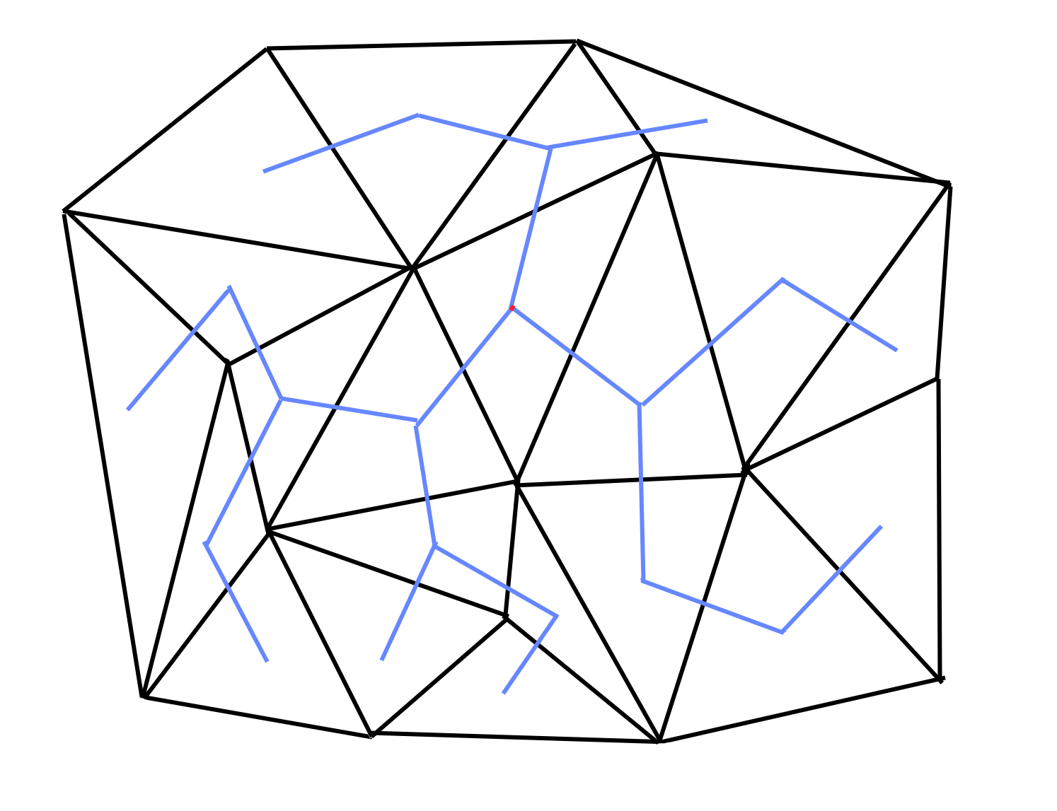
Spanning tree over triangles (and feature edges)

Slide 6
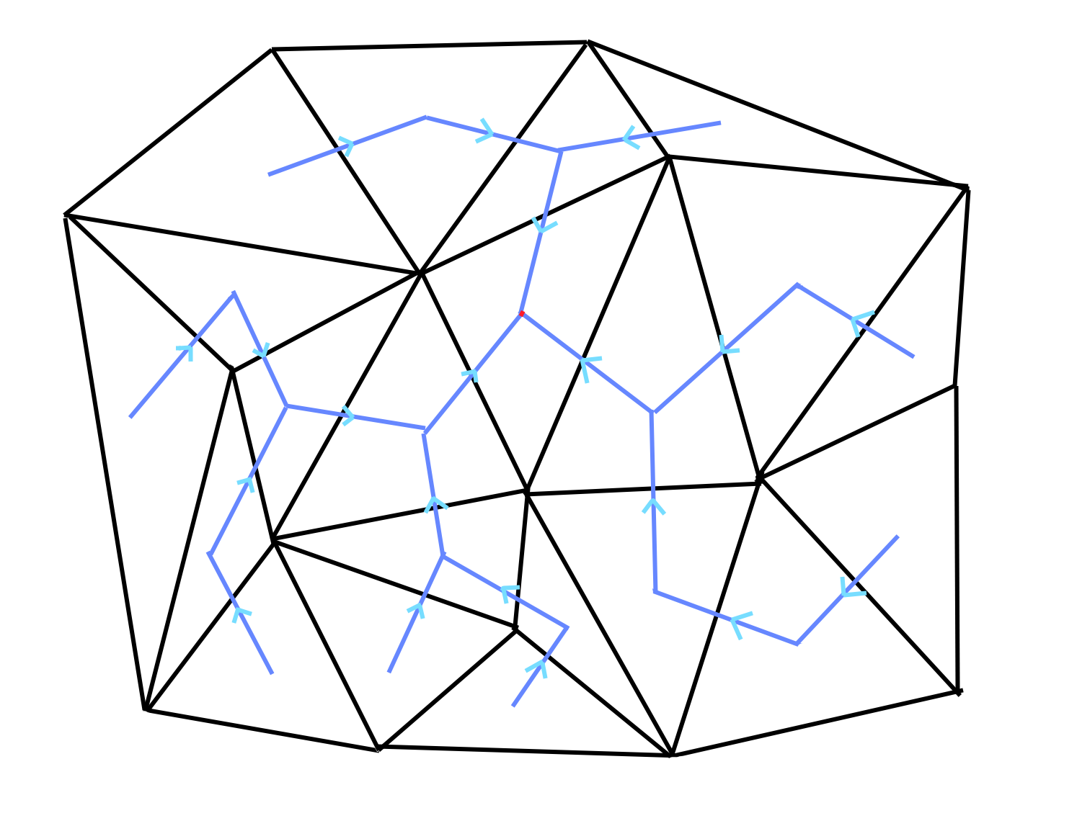
Error propagation

Slide 7
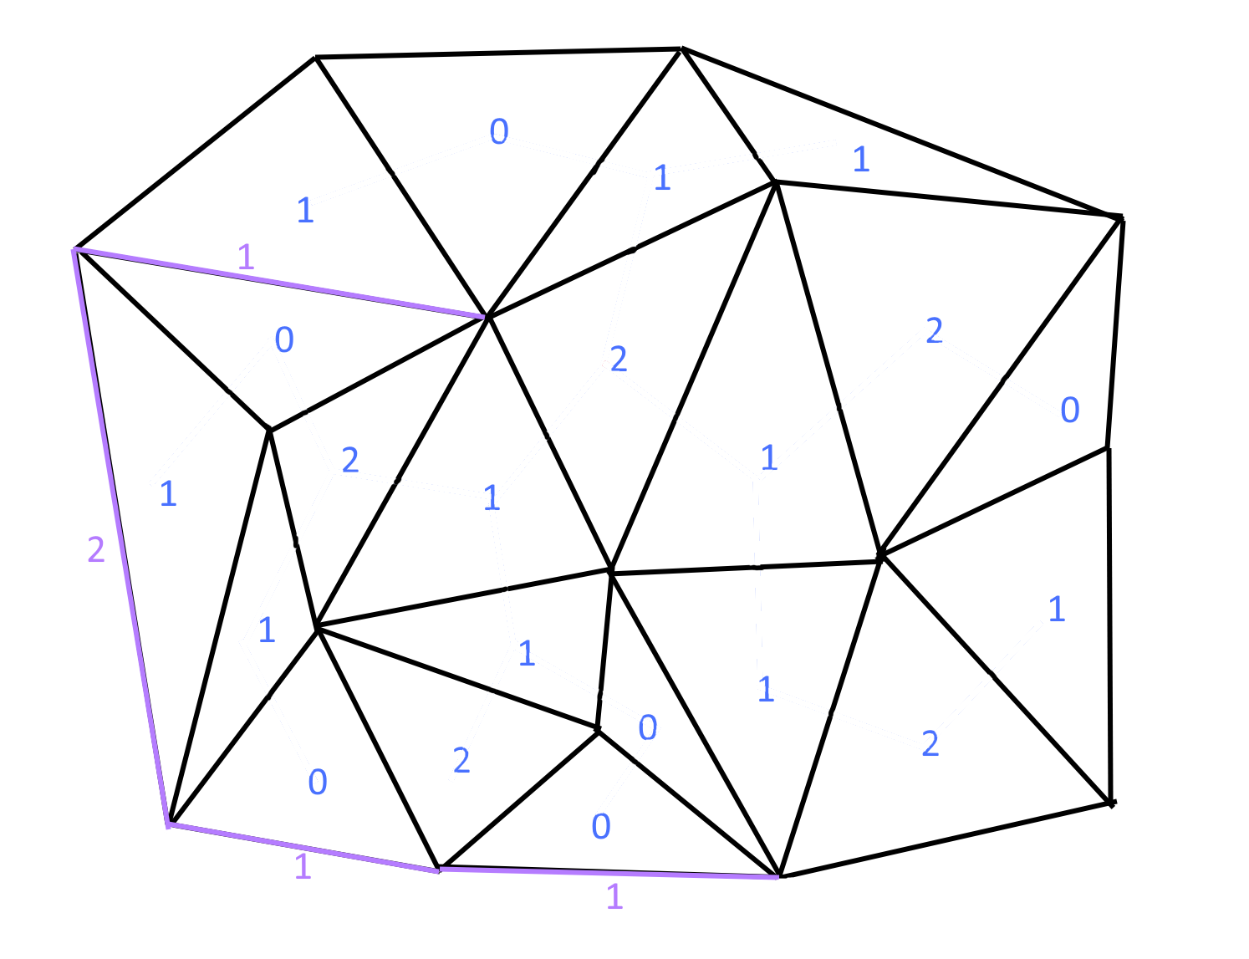
Vertices budget for each triangle and feature edges

Slide 8
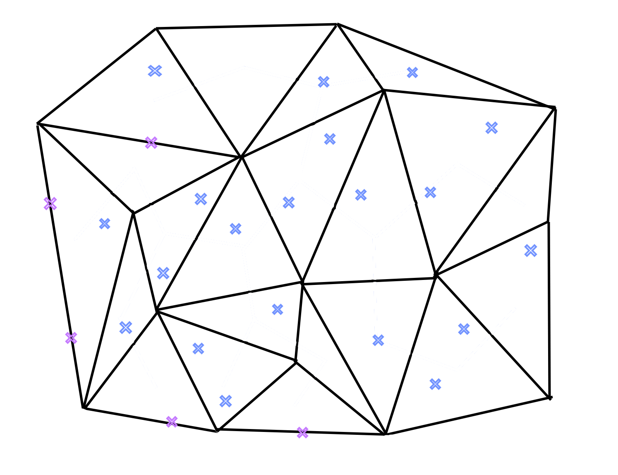
Place randomly vertices

Slide 9
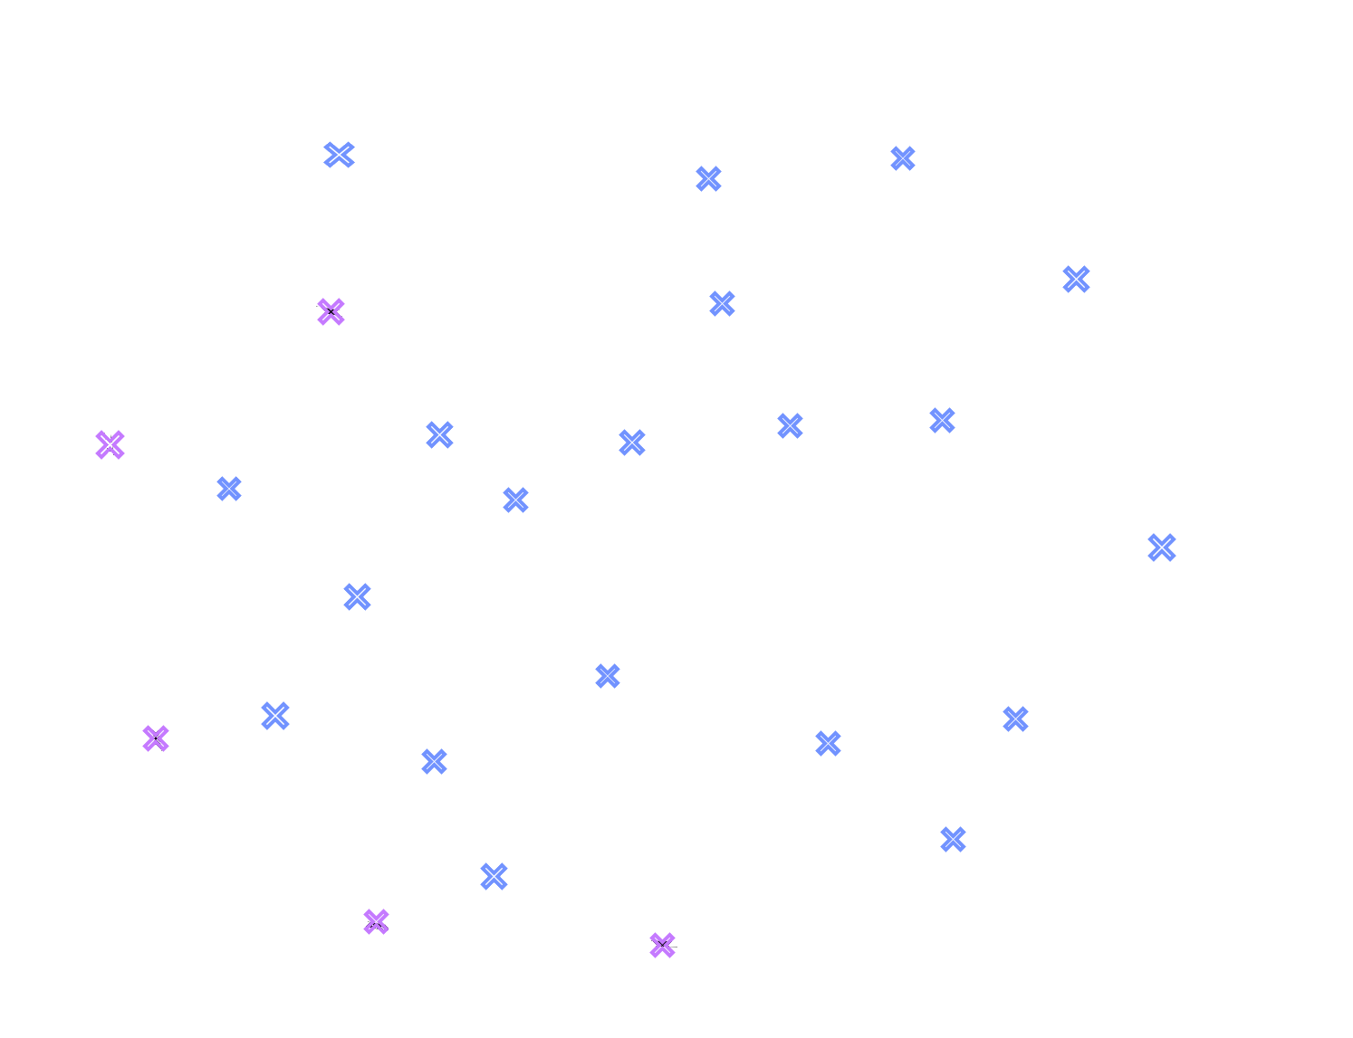
Place randomly vertices

Slide 10
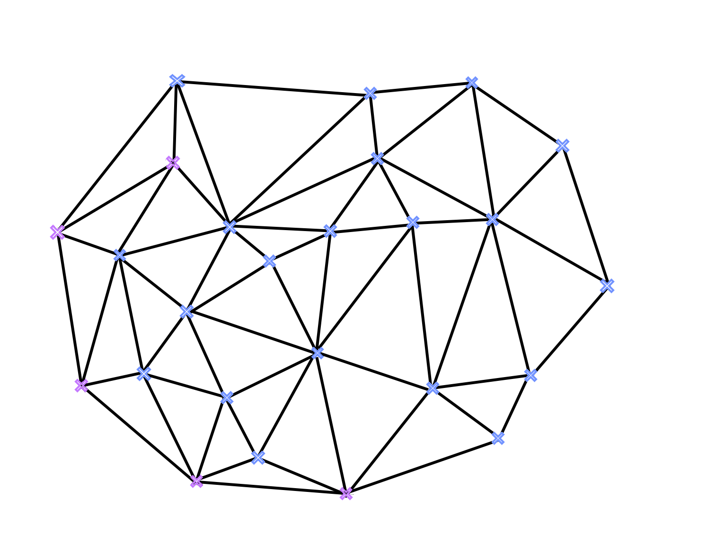
Perform a Delaunay triangulation

Slide 11
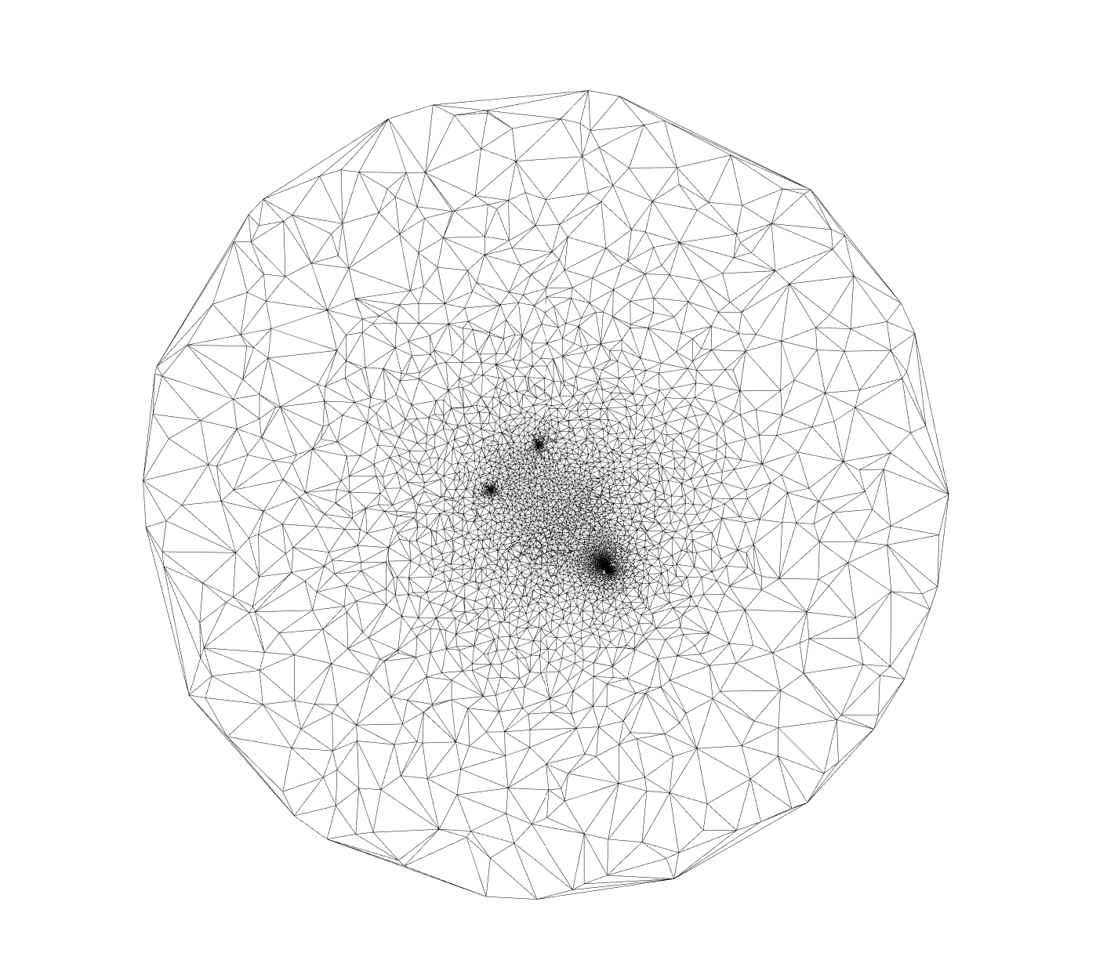
Delaunay triangulation for camel head
Original parameterized mesh
Delaunay triangulation

Slide 12
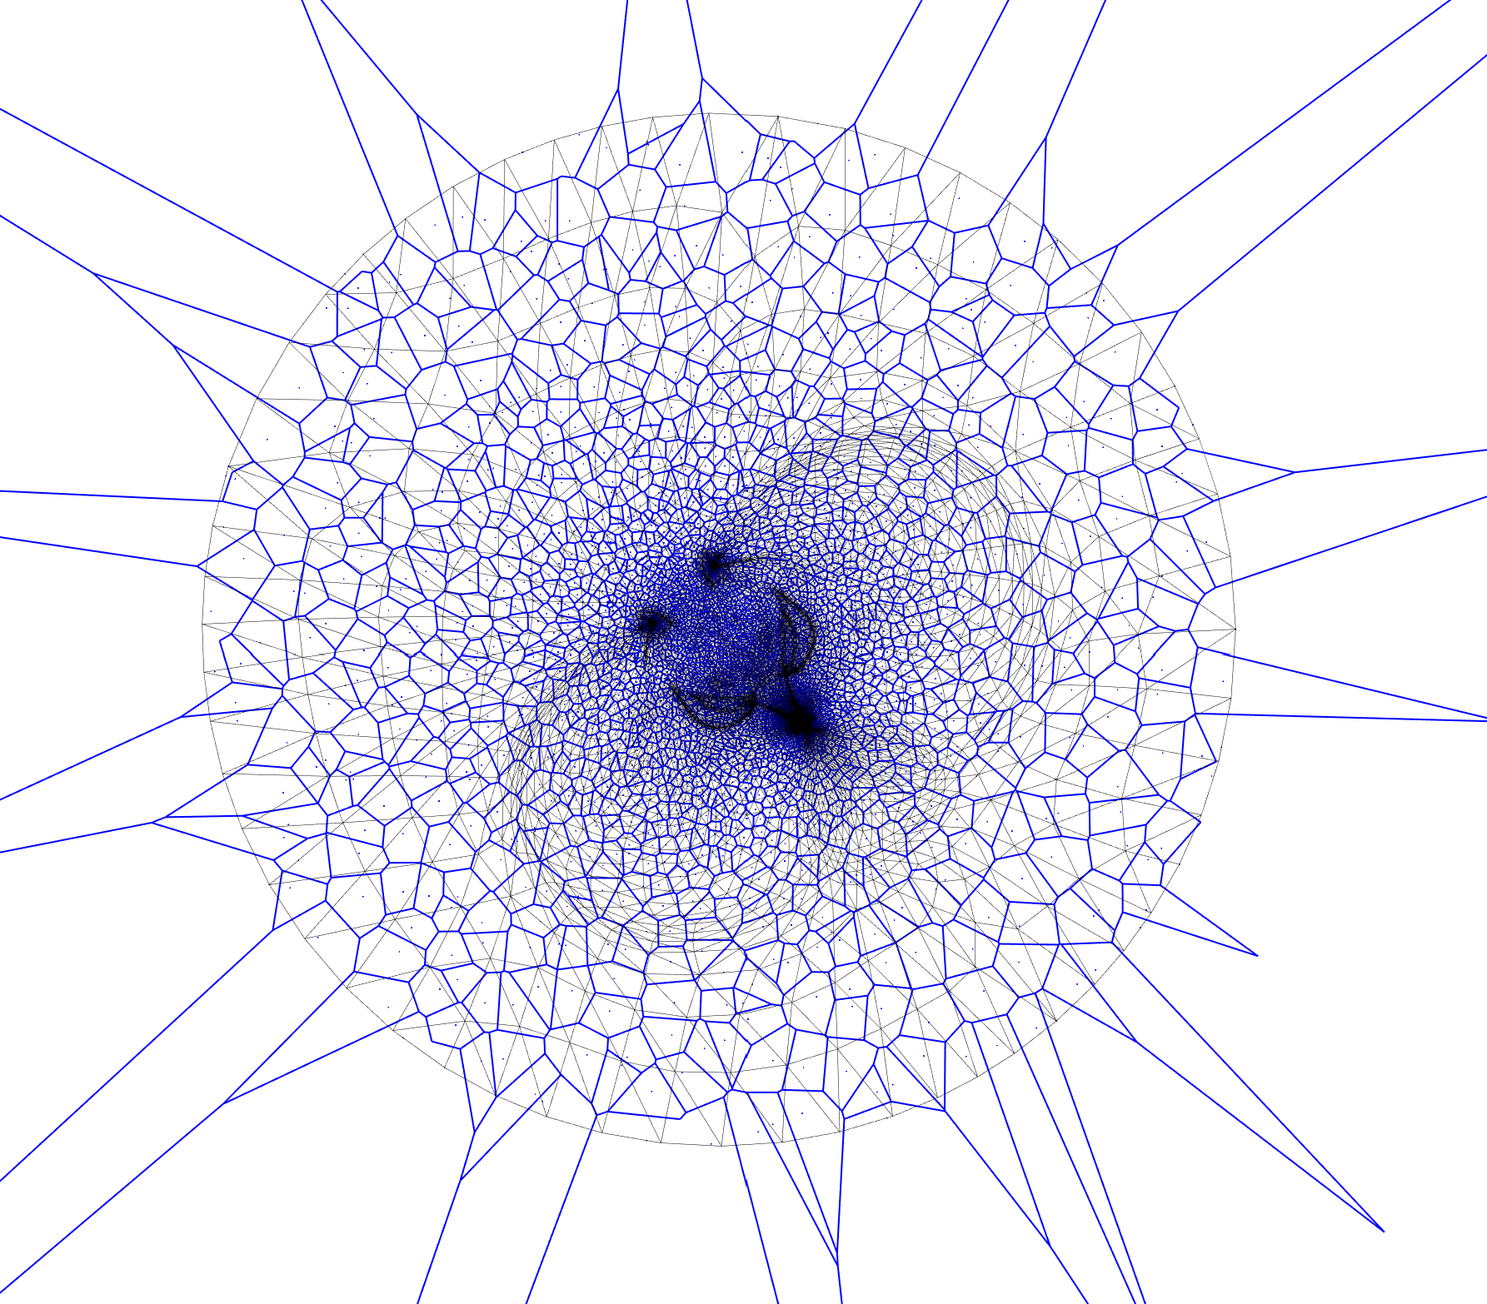
Voronoi tessellation lying on the original parameterized mesh
In blue the voronoi tesselation
In black the original parameterized mesh

Slide 13
Time that takes doing each steps
Conformal parameterization
Create maping of edge to triangle and vertices to it’s neighbors
Extract Feature edges and corners
Creat the spanning tree on triangles and feature edges
Perform the uniforme density
Error propagation
Initial sampling (using random sampling)
Compute Delaunay triangulation with Delaunator
Compute voronoi tessellation
: 505ms
: 294ms
: 345ms
: 132ms
: 154ms
: 38ms
: 15ms
: 14ms
: 1155ms

